Slide 1
Revolutionizing Traffic Management: Building Next-Generation Traffic Information Platform and Mobile Apps with Web Development Technologies

Slide 2
1. Introduction: Importance of Traff ic Management
In the world of traffic management, the next revolution is underway. With the power of web development technologies, we are building a cutting-edge traffic information platform and mobile apps that will disrupt the way we navigate through cities. Get ready for a seamless, intuitive experience that will revolutionize the way we travel and optimize tra c ow like never before.

Slide 3

2. Challenges with Traditional Traffic Management Systems
While traditional traffic management systems have served their purpose, they come with several challenges. These include outdated infrastructure, limited real-time data, and lack of user-friendly interfaces. By embracing web development technologies, we can overcome these challenges and create a next-gen tra c information platform that provides up-to-date information, user-friendly interfaces, and innovative features to optimize tra c ow e ciently.

Slide 4

3. The Need for a Next-Gen Traffic Information Platform
To address the limitations of traditional traffic management systems, a next-gen traffic information platform is necessary. This platform will revolutionize traffic management by providing real-time and accurate information, user-friendly interfaces for easy navigation, and innovative features like predictive analysis and personalized recommendations. With the use of web development technologies, we can create a seamless and e cient tra c management solution that improves overall tra c ow and enhances the commuting experience for all.

Slide 5

4. Exploring Web Development Technologies for Traf ic Management
When it comes to building a next-gen traffic information platform and mobile apps, web development technologies play a crucial role. By leveraging technologies such as HTML5, CSS3, JavaScript, and APIs, we can create responsive and interactive interfaces that deliver real-time tra c updates, personalized recommendations, and predictive analysis. These technologies empower us to revolutionize
tra c management, improve tra c ow, and enhance the overall commuting experience for citizens.

Slide 6
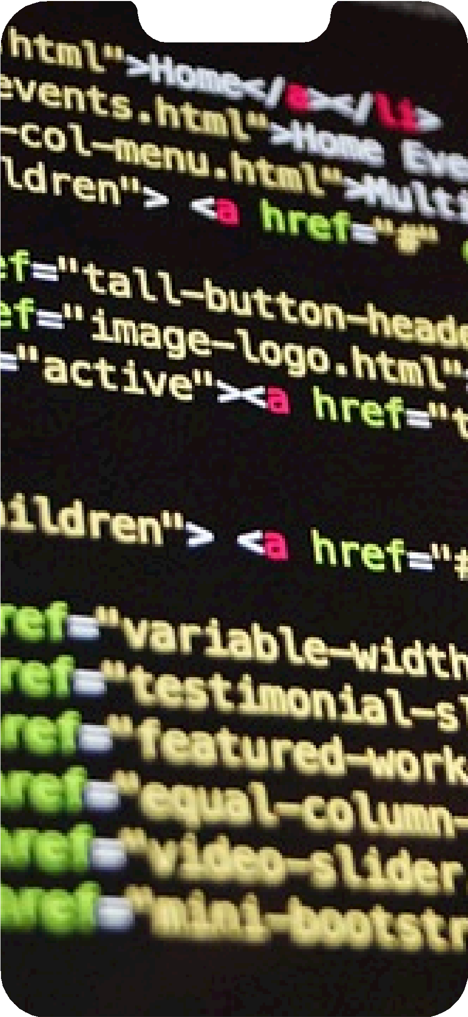
5. Building a Scalable and Reliable Traff ic Information Platform
To build a scalable and reliable traffic information platform, we need to consider several factors. First, we must ensure that our server infrastructure can handle high volumes of data and user requests. Second, implementing efficient caching techniques will help optimize response times. Third, incorporating redundancy and failover mechanisms will ensure uninterrupted service. Additionally, we should regularly monitor and analyze the platform's performance to identify and address potential bottlenecks.

Slide 7
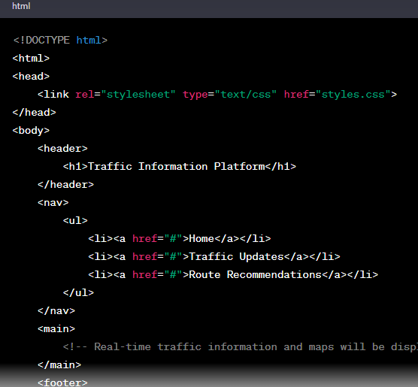
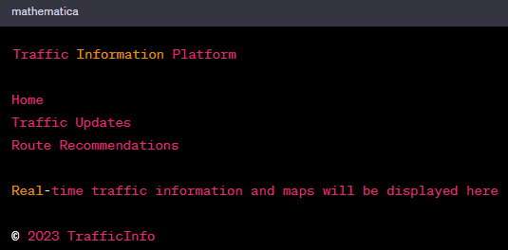

STEP1:Design the User Interface
OUTPUT:

Slide 8
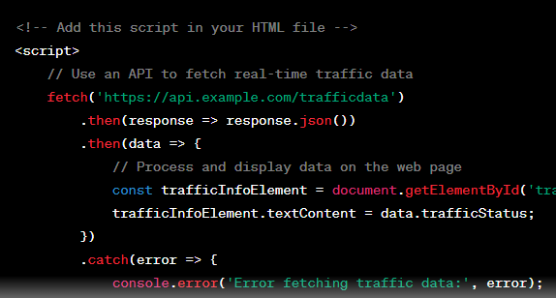
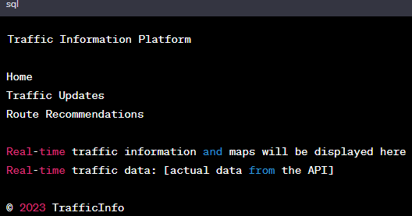
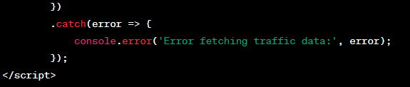
STEP2:Implement Real-Time Traffic Data
OUTPUT:

Slide 9
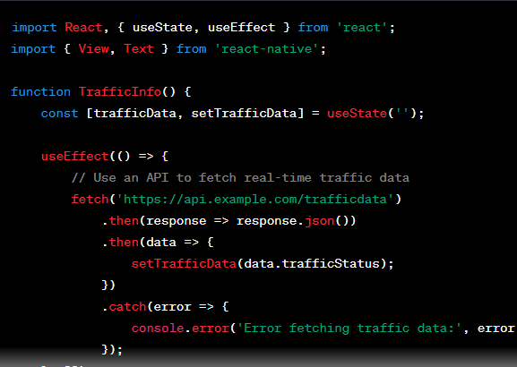
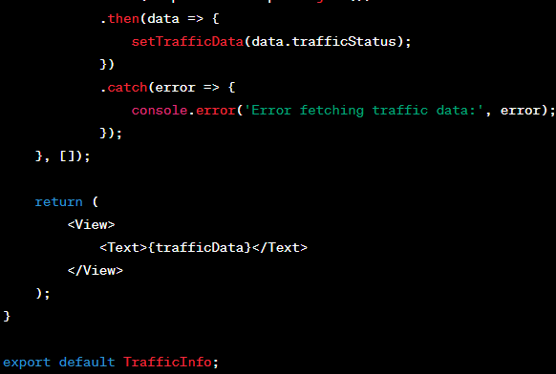
JAVA SCRIPT PROGRAM WITH OUTPUT:

Slide 10

OUTPUT FOR JAVA:

Slide 11
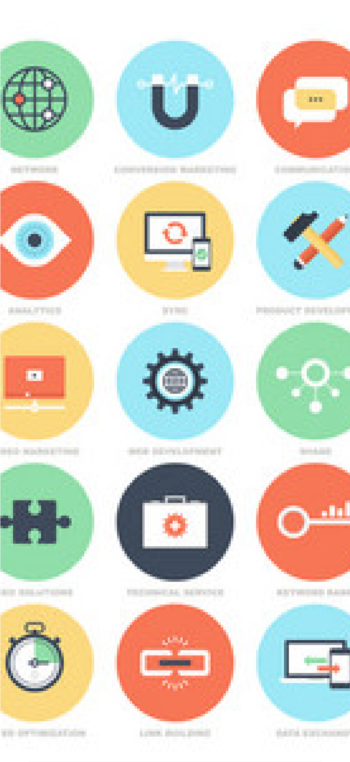

6. Leveraging Mobile Apps for Real-Time Traf ic Updates
Mobile apps play a crucial role in providing real-time traffic updates to users. By leveraging web development technologies, we can create intuitive and user-friendly mobile apps that deliver accurate and up-to-date information. These apps can enhance the user experience by o ering features such as personalized routes, live tra c
noti cations, and alternative route suggestions, revolutionizing the way people navigate through tra c.

Slide 12
7. User-Centric Design and Intuitive UI for Traf ic Apps
To create a successful traffic information platform, user-centric design and intuitive UI are crucial. By
prioritizing user experience, we can ensure that the app is easy to navigate and provides relevant, accurate
information. Intuitive UI elements such as clear visual cues, simple icons, and seamless interaction will enhance the usability and e ectiveness of the app, revolutionizing the way users interact with tra c data.

Slide 13
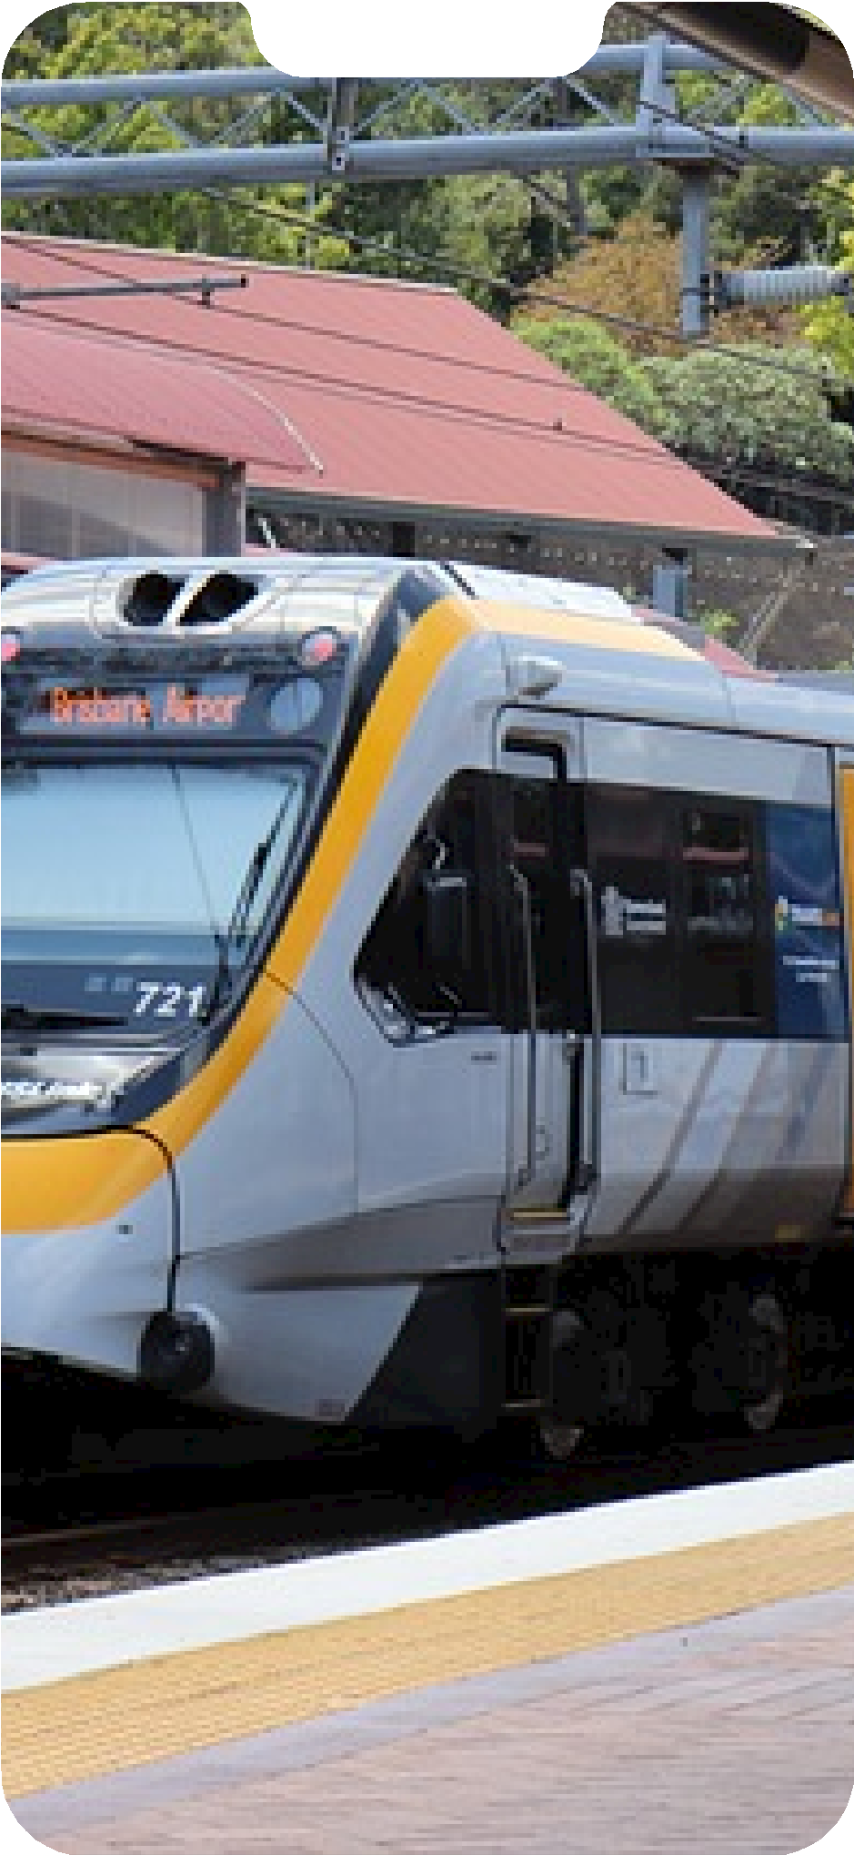
8. Integration with IoT and Smart City Infrastructure
To further enhance the capabilities of our traffic information platform, we will integrate it with IoT devices and leverage the infrastructure of smart cities. By connecting with sensors, cameras, and other IoT devices, we can gather
real-time data and provide more accurate and precise tra c information. This integration will revolutionize tra c management and lead to smoother, more e cient transportation systems in smart cities.

Slide 14

9. Ensuring Data Security and Privacy in Traf ic Management
As we revolutionize traffic management with our next-gen platform and mobile apps, ensuring data security and privacy is of utmost importance. By implementing robust encryption protocols, access control measures, and regular security audits, we can protect sensitive information and give users peace of mind. Our commitment to data privacy will build trust and encourage widespread adoption of our innovative tra c solution.

Slide 15

10. Future Possibilities and Further Enhancements
With our next-gen traffic information platform and mobile apps, the possibilities for revolutionizing traffic management are endless. We can explore incorporating real-time updates on road conditions, predictive analytics for traffic patterns, integration with smart city infrastructure, and even AI-powered tra c control systems.

